Slide 1
Security.

Slide 2
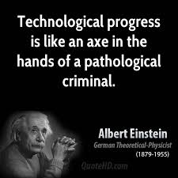
Security why?.
Valuable information
Technical, commercial, financial, legal
Business continuity / Disaster recovery
IT is critical to the enterprise
Reputation, brand value
→ C.I.A. approach
Confidentiality, Integrity, Availability
Applicable to data and systems

Slide 3
Motivations.
Confidentiality: (External) attack protection
data are one of the most precious resource of an enterprise (customer files, products info...)
Integrity: Tampering & Error protection
full proof process can’t be influenced by wrong processes
Availability: Disaster recovery
DOS, Loss of systems, data (disk failure)

Slide 4
Incidents classification: - availability.
Denial of service (DOS) attacks
Malicious code
Self replicating, trojan horse, worm, bomb
Hardware/Software failure
Partners / Providers failure
Facility Infrastructure failure
Power, natural disasters, evacuation

Slide 5
Incidents classification: – confidentiality & integrity.
Unauthorised privileged access (root, admin)
Use of privileges without authorisation
Unauthorised user access
Use of user privileges without authorisation
Unauthorised unsuccessful attempt
E.g. multiple password trials
Unauthorised probe
Site scanning

Slide 6
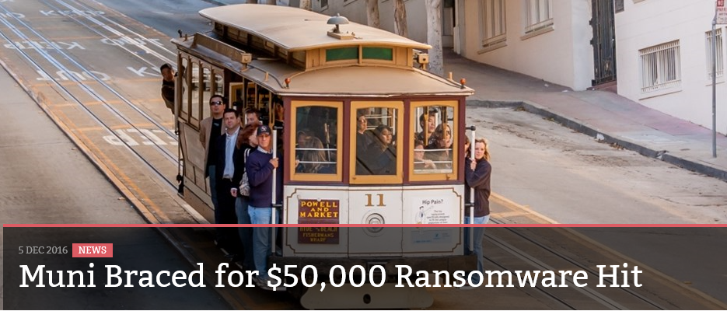
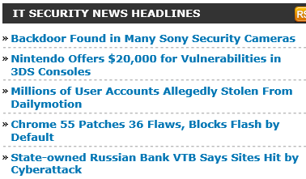
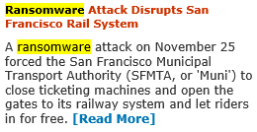

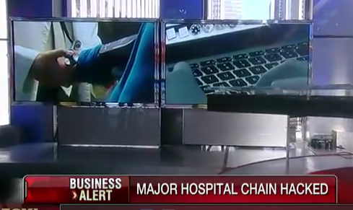
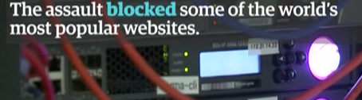
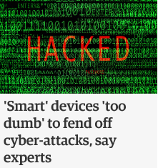

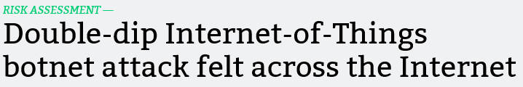

Slide 7
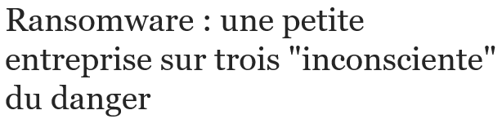




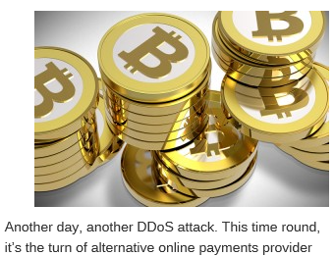


Slide 8


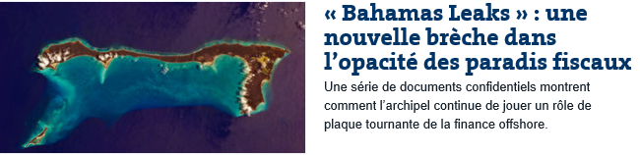


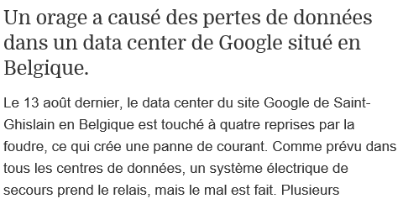


Slide 9
Methods
Protection
Detection
Eradication
Recovery
Notes:
On se concentrera sur les aspects protection

Slide 10
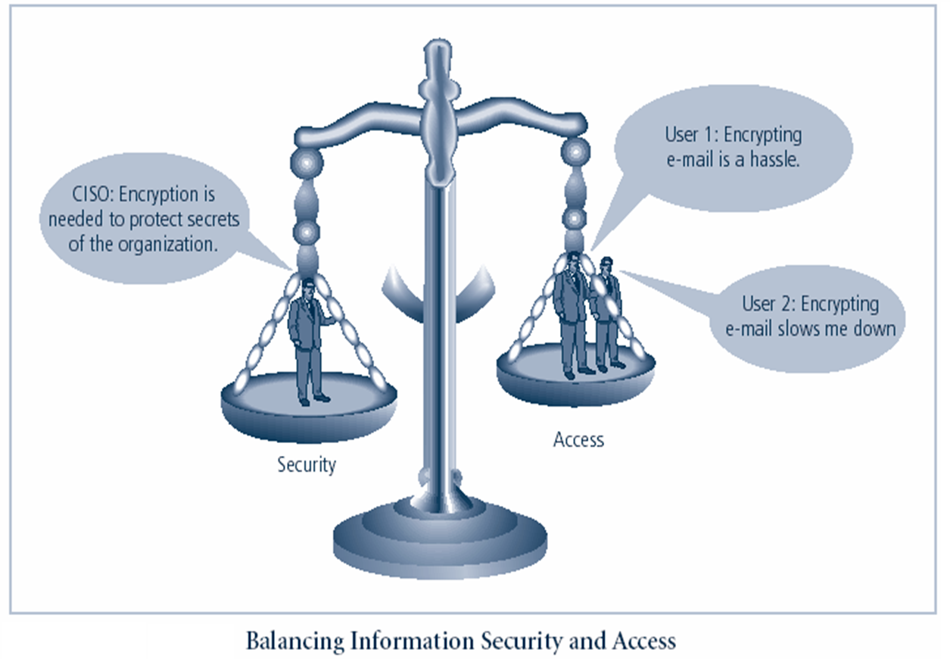
Computer threads.
Internet (Web)
Source Code
E-mail
Files

Slide 11
Network protections.
Firewalls
Allow, block, drop connections
WAF – Web Application Firewall
Cross-site scripting, SQL injection, session hijacking, buffer overflows…
Intrusion detection (network or host based)
Vulnerability scanning (internal, external)
…

Slide 12
Basic protections at facility / systems level.
Dual(+remote) site: redundant data and hardware
Physical protection, dark room
Back-up politics
Fault tolerant equipment (facility, clusters, RAID…)
Strong authentication
Authorisation: access right on resources through security packages.
O/S built-in protections + firewalls, anti-virus…
Application protection (data validation, signatures…)
Notes:
Facility : immobilier et fournitures…

Slide 13
Resource protection model.
Resources
Processes
Users

Slide 14
Define Policies and mechanisms.
Mechanism is a set of components ( hardware of software ) used to implement any strategies:
operating systems
security packages
encryption
Policy is a particular strategy that dictates the way a mechanism is used to achieve specific goals.
Notes:
Définitions - terminologie

Slide 15
Basic security mechanisms.
Authentication:
external (user auth) or internal (process auth)
Authorisation:
an authenticated user or process is allowed to use resources according to the defined policy
Encryption:
based on public or private keys

Slide 16
Authentication.
User authentication.
Classically based on combination user-id and password
Additional/alternative information may be required
digital signature techniques
synchronised calculator
fingerprint, eye scan, photograph
SMS
Penetration attempt stopped by terminating connection after some threshold.

Slide 17
Authentication.
Network authentication.
File transfer is the most common way used to penetrate a system
viruses: software module hidden in another one
worm: software executed by itself
e.g. Internet’s worm tru Finger (1988!), VB script in e-mail
Code hidden in web pages
…

Slide 18
Introduction to Kerberos
A centralised network authentication system developed at MIT
A secret key based service for providing authentication in open networks
Based on a trusted 3rd party on the network
Standards based strong authentication system
Wide support in various operating systems

Slide 19
Kerberos: 3 phases of authentication
Phase 1
The client requests a ticket from the Kerberos
Kerberos grants a ticket and a session key
The ticket is used for requesting other tickets for various services
Ticket (credentials) conveys the identity of the client to the server
The session key is used for conversation between the client and the server

Slide 20
User Authentication: session key distribution
Auth server
1
Ticket granting ticket
3
2
Client
Client ID
Client ID
Session key
Session key
4
Session key
Ticket
5
Session key
4
Server
Client ID
Session key

Slide 21
Kerberos: 3 phases of authentication (2)
Phase - 2
The client uses the ticket of the first phase to request a ticket from the ticket granting server (tgs) for a specific service
Phase 3
The client presents the key to the server for the service

Slide 22
Client-Server Authentication: Service tickets distribution.
KDC : Key Distribution Center
Ticket Granting
Service (TGS)
Auth server
1
4
3
Ticket granting ticket
Service Ticket
2
Client
Client ID
Client ID
Session key
Session key
Session key
5
Server
6

Slide 23
Kerberos – Summary
Each user and service shares a secret key with the KDC
Users enter password on local machine only, once per day/session, no password travel over the network
KDC first generates a TGT, valid for the day
TGT used to get other service tickets, limited in lifetime and service.

Slide 24
Internal access authorisation.
Try to protect process’s resources from actions performed by other processes
Classical protection problems:
sharing: call procedures in other’s address space
Trojan horse: take advantage of a server process

Slide 25
Protection system
Process
Resource
Process
Resource
Process
Resource
Process
Resource
Processes
Objects
Access authen
a
Resource
Access matrix
translated in access
control list ( ACL )
May process P perform
function a against res R
Processes

Slide 26
ACL types
On resources describe
Rights, typically Read / Write / Execute / Delete
For persons, groups, processes…
On network traffics, impose rules on in- and out- packets
IP addresses
protocols

Slide 27
Role based access control (RBAC)
Used by big companies to address complexity of management of individual rights
Security also based on « need to know »
A user has one or multiple roles
A role requires a number of permissions
E.g. a programmer, a branch employee, a payment officer…

Slide 28
Cryptography.
Convert plain text into ciphered text
encrypt and decrypt functions
public algorithm and secret key
public key and secret algorithm
symmetric encryption:
encryption and decryption keys are the same
internal use in one local O/S for passwords
asymmetric encryption
using public and private key
external use when encryption and decryption are performed by different actors.

